Slide 1
Voter Registration Champions
A guide for organisations seeking accreditation with Citizens UK
www.voterchampion.org.uk

Slide 2
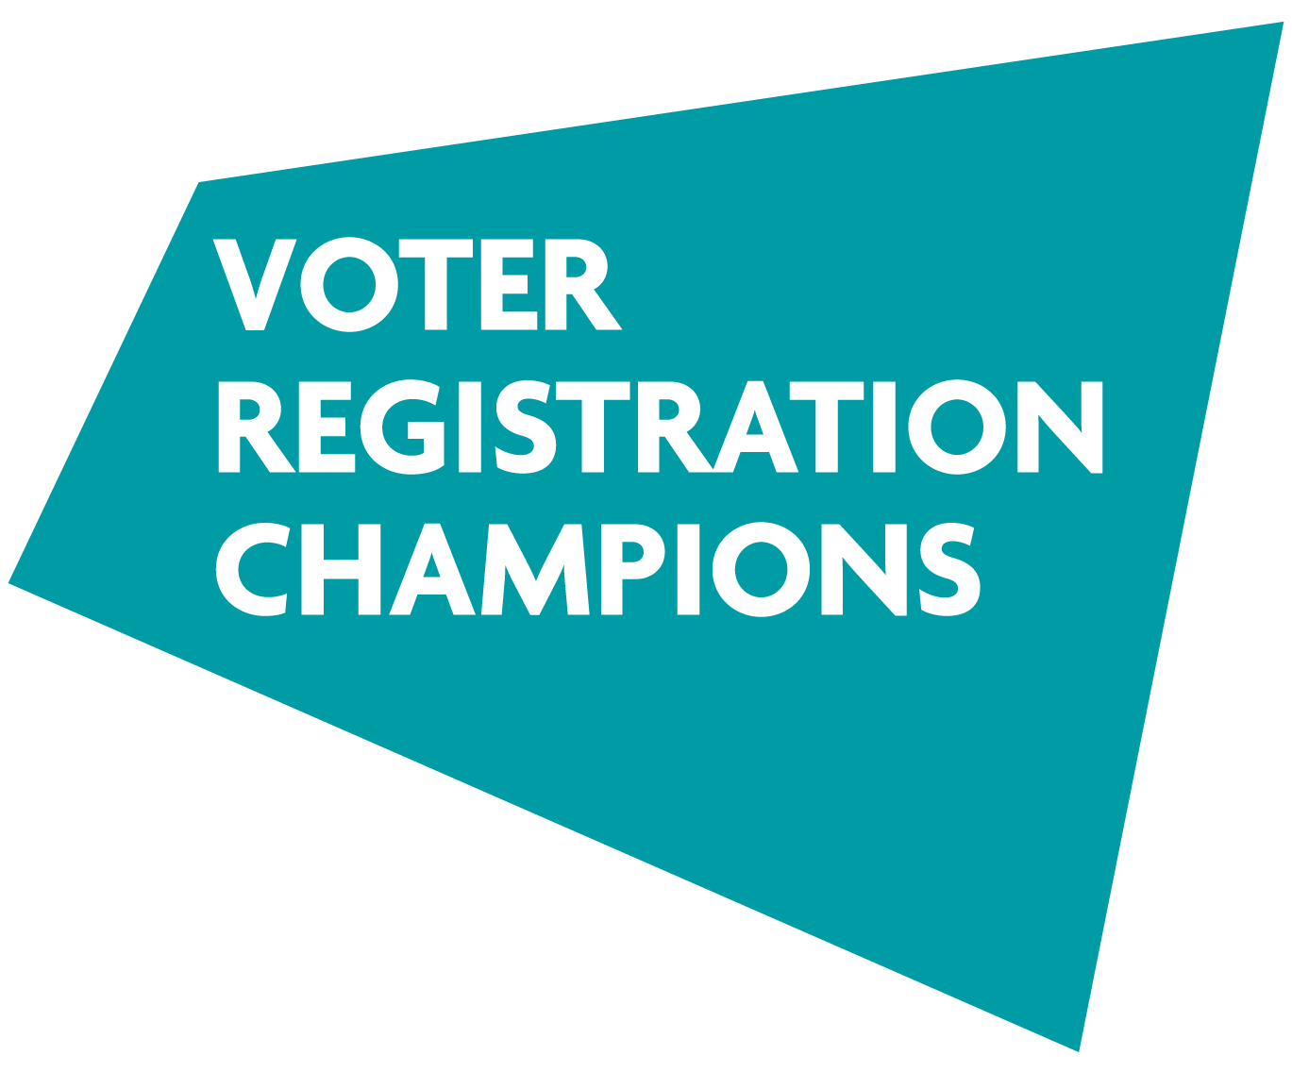
There will be a UK General Election by January 2025. The Electoral Commission estimates that 8 million eligible voters will miss out because they are not properly registered...

Slide 3
What's the problem we are trying to solve?
Research from the Electoral Commission suggests:
8 million eligible voters may not vote at the next General Election because they didn't register to vote in time;
4 million eligible voters may not vote at the next General Election because they do not have appropriate Photo ID;
14 million eligible voters may not vote at the next General Election because they are not motivated to turn out to vote on election day.
You are at greater risk of not being able to participate in the democratic process if you are: young, a non-UK national, rent your home, have moved recently, live in an economically-disadvantaged community, or are from an ethnic minority.
Source: Electoral Commission – 2023 Report: Electoral Registers in the UK

Slide 4
Citizens UK has demonstrated that we can register tens of thousands of people to vote through community organising...

Slide 5
We know how to do Voter Registration
Citizens UK has over a decade’s experience of registering people to vote through community organising;
We are recognized as an organisation that can reach those communities most likely to be excluded from the democratic process: young people, migrant communities, and diverse & economically-disadvantaged inner-city areas;
Voter Registration links to our 3 Strategic Aims:
Developing Leaders: we train leaders to register others to vote;
Strengthening Institutions: we focus voter registration campaigns around civil society organisations;
Making Change: we have registered tens of thousands of people to vote over the years.

Slide 6
…and we’ve also shown that we can accredit tens of thousands of organisations as Living Wage employers…

Slide 7
We know how to accredit organisations that are doing good
The Living Wage campaign has grown from a campaign rooted in community organising to a movement of over 14,000 employers now accredited by the Living Wage Foundation;
The Living Wage campaign is one of the leading examples of ‘voluntary regulation’ in the UK – it works because we recognise employers for doing the right thing;
We have developed an effective system of accreditation that has enabled the campaign to achieve scale – and influence the debate on low pay in the UK.

Slide 8
…so now we are combining community organising with an accreditation scheme that will enable any organisation to accredit as a ‘Voter Registration Champion’!

Slide 9
Voter Registration Champions

Slide 10
What is the ‘Voter Registration Champion’ scheme about?
GETTING A BADGE: A ground-breaking non-partisan accreditation scheme that offers a Voter Registration Champion badge to organisations that take simple steps to ensure their members can participate in democracy;
SKILLING UP: A one-stop shop to equip organisations to register people to vote, educate people about the new Voter ID requirements, and encourage turnout on election day;
MAKING A DIFFERENCE: A way to join a movement to make sure 300,000 at-risk voters are registered and equipped to cast their vote ahead of the next General Election.

Slide 11
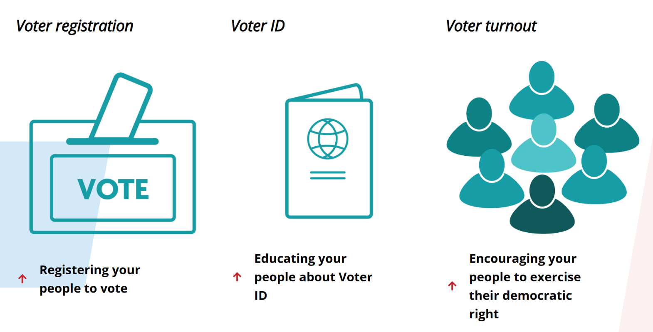
What three things do all ‘Voter Registration Champions’ do?

Slide 12
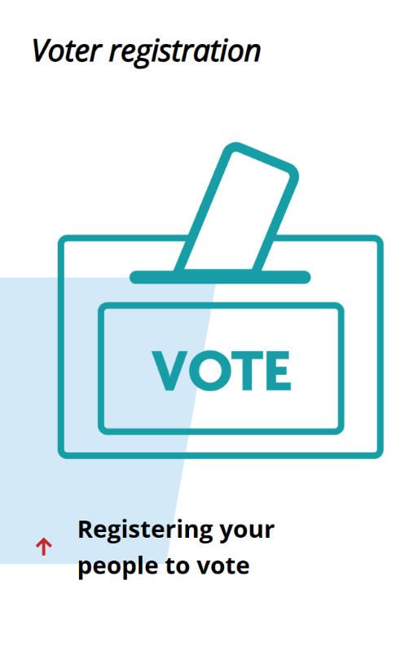
1. VOTER REGISTRATION ACTIONS
WHAT? Run an annual Voter Registration campaign in your organisation.
WHY? If you are not registered to vote, you won’t be able to vote at the next general election. We are aiming to make sure that 300,000 eligible voters don’t lose their right to vote because they aren’t registered.
HOW? It is easy to register to vote – there’s a simple online form or you can fill in a paper version and send it to your council. Your organisation will need to work out the best way to reach your members and help them to register.
WHEN? Any time before the voter registration deadline (which tends to be a few weeks before the election). Work out when best suits your organisation. Make sure you take advantage of Voter Registration Month (September 2024).

Slide 13
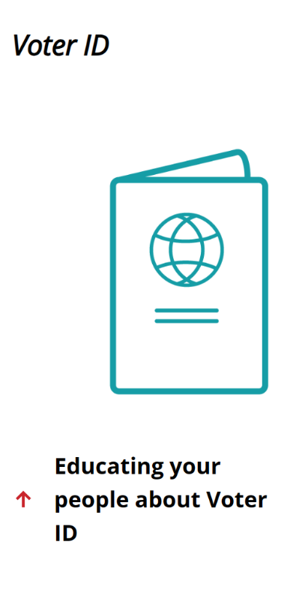
2. VOTER ID ACTIONS
WHAT? Make sure all your people are aware of the new Voter ID regulations, and what ID they will need in order to vote.
WHY? The rules are changing for the next general election – if you don’t take photo ID to the polling station you won’t be able to vote. We need to remind people, and help those without ID to apply for a free photo ID document from their council.
HOW? You will know best how to get the message to the people you need to reach in your organisation. We’ll provide the materials to help you.
WHEN? Any time before the voter registration deadline (which tends to be a few weeks before the election). Work out when best suits your organisation. Voter Registration Month (September 2024) would be a good time to do this.

Slide 14
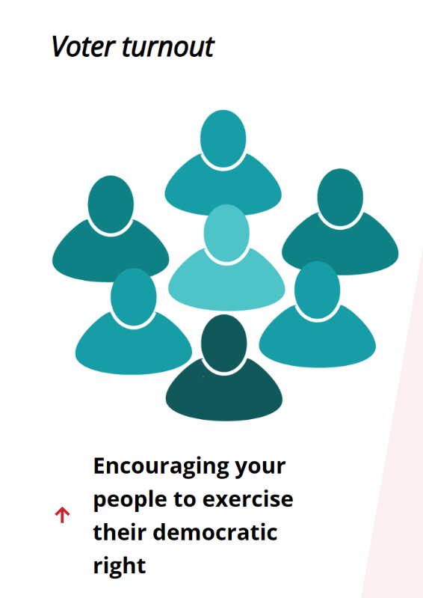
3. VOTER TURNOUT ACTIONS
WHAT? Remind your people about the general election and encourage them to use their vote.
WHY? Voting is the cornerstone of our democracy. If people don’t vote they won’t get a say on who gets to make decisions that affect their lives.
HOW? Again, you are the experts on your organisation. We’ll have provided some ideas in the training, but think about how to get the message across.
WHEN? In the run-up to election day – we don’t know when that will be exactly.

Slide 15
What are the accreditation criteria for an Employer?
VOTER REGISTRATION: Run an annual Voter Registration campaign to promote the opportunity to register to vote to 100% of your staff before the deadline.
VOTER ID: Send information about the Voter ID requirements to every staff member ahead of the deadline for applying for photo ID.
VOTER TURNOUT: Remind every staff member about the election date, and encourage them to use their vote.
VOTER REGISTRATION MONTH (SEPTEMBER 2024): Help build the movement by participating in 'Voter Registration Month' activities.

Slide 16
Employer Case Study: Anchor Removals and Storage
Anchor Removals and Storage has 11 employees and is based in Greater Manchester. The company has decided to become a Voter Registration Champion;
The owner of the company, Chris Smallwood, works with his team to develop a plan to promote Voter Registration to his workers;
Voter Registration and Voter ID: The company plans to use its internal communication platform to make sure all their staff have the information and support about Voter Registration and the Voter ID requirements they need in order to vote at the next election. They also plan to discuss why voting is important at their monthly team meeting;
Voter Turnout: The company will let their staff take time out to vote on polling day if they need it – and if they are scheduled to be working away that day the company will make sure they know how to get a postal vote.
“I’m proud that our company is the first employer in the UK to accredit as a Voter Registration Champion. These are small steps that can make a big difference, and we hope that lots of other employers will follow our example.”
Chris Smallwood, Owner of Anchor Removals and Storage

Slide 17
What if my organisation wants to go even further?
For organisations that want to go further than the basic accreditation criteria (Bronze) for their sector, Silver and Gold Voter Registration Champion status will also be available;
Silver Voter Registration Champion status is awarded to organisations that fulfil the basic criteria (Bronze) and also support other organisations in their area to register people to vote;
Gold Voter Registration Champion status is awarded to organisations that fulfil Bronze and Silver criteria, and in addition register 5,000 people to vote each year.

Slide 18
What does my organisation need to do to accredit as a ‘Voter Registration Champion’?
ESTABLISH ORGANISATIONAL BUY-IN: Make sure your organisation is willing to take an active role in registering your people to vote, encourage democratic participation, and fulfil the relevant accreditation criteria.
BUILD A TEAM: As well as getting buy-in from the key decision-makers, you’ll need a named senior contact and a team of people who are willing to do the work – including at least one person to attend an online training with Citizens UK.
WORK OUT A PLAN: Decide how your organisation will go about achieving each of the accreditation criteria, as well as how you will gather the data to demonstrate that you have met the accreditation criteria.
SUBMIT YOUR LICENSE APPLICATION: Send us the information we need to accredit you as a Voter Registration Champion. We will ask you to send us an update each year to renew your accreditation.
CELEBRATE YOUR ACHIEVEMENT!: You’ll be able to use the Voter Registration Champion badge and logo to show your leadership in promoting democratic participation.

Slide 19
What support will Citizens UK provide ‘Voter Registration Champions’?
A SIMPLE ACCREDITATION PROCESS: Based on the successful Living Wage Foundation accreditation process, organisations will find a simple accreditation process on our website.
COMPREHENSIVE RESOURCES: Our website will be a one-stop shop for resources to help you become a Voter Registration Champion, including 'how-to' guides, case studies, and sector-specific guidance.
REGULAR COMMUNICATIONS: Our monthly updates will offer the latest news & resources.
REGULAR TRAINING: We'll offer free online training on a regular basis led by experienced experts to help you fulfil the requirements of the Voter Registration Champion scheme.
BESPOKE SUPPORT FOR LARGE ORGANISATIONS: If your organisation will impact more than 10,000 people then we can provide bespoke staff support if needed.
RESOURCES TO CELEBRATE YOUR ACHIEVEMENT!: We'll provide a resource pack to help accredited organisations to celebrate and promote their Voter Registration Champion status.
VOTER REGISTRATION MONTH: We'll organise a month of activities ahead of the election (September 2024) that will celebrate accredited Voter Registration Champion organisations.

Slide 20
Start your journey to becoming an accredited ‘Voter Registration Champion’: www.voterchampion.org.uk/employer-accreditation/

